Slide 1
LAB – 08
Functions - II

Slide 2
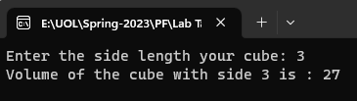
Task - 1
Write a program to calculate the cube of a number by using inline functions.

Slide 3
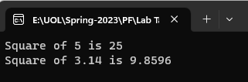
Task - 2
Create two overloaded square( ) functions to calculate the square of an input value. The input should be of types int, and float. Write a main( ) program that exercises these overloaded functions with these argument types.

Slide 4
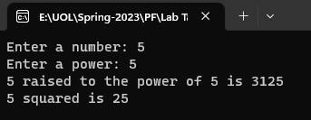
Task - 3
Write a C++ program that defines a function called power() to calculate the power of a number. The function takes a double value for n and an int value for p, and returns the result as a double. The default value of p is 2. The program should prompt the user to enter the values of n and p, and then call the power() function to calculate the result.

Slide 5
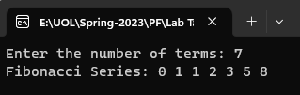
Task - 4
Write a C++ program to print Fibonacci series using call-by-reference method.

Slide 6

Task - 5
Write a C++ program to find the factors of a number using function.

Slide 7
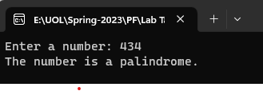
Task - 6
Write a C++ program to check whether a Number is a Palindrome or not using function.

Slide 8
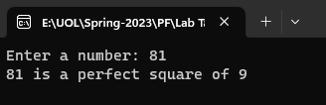
Task - 7
Write a C++ program to check whether a Number is a perfect square or not using function.

